Slide 1
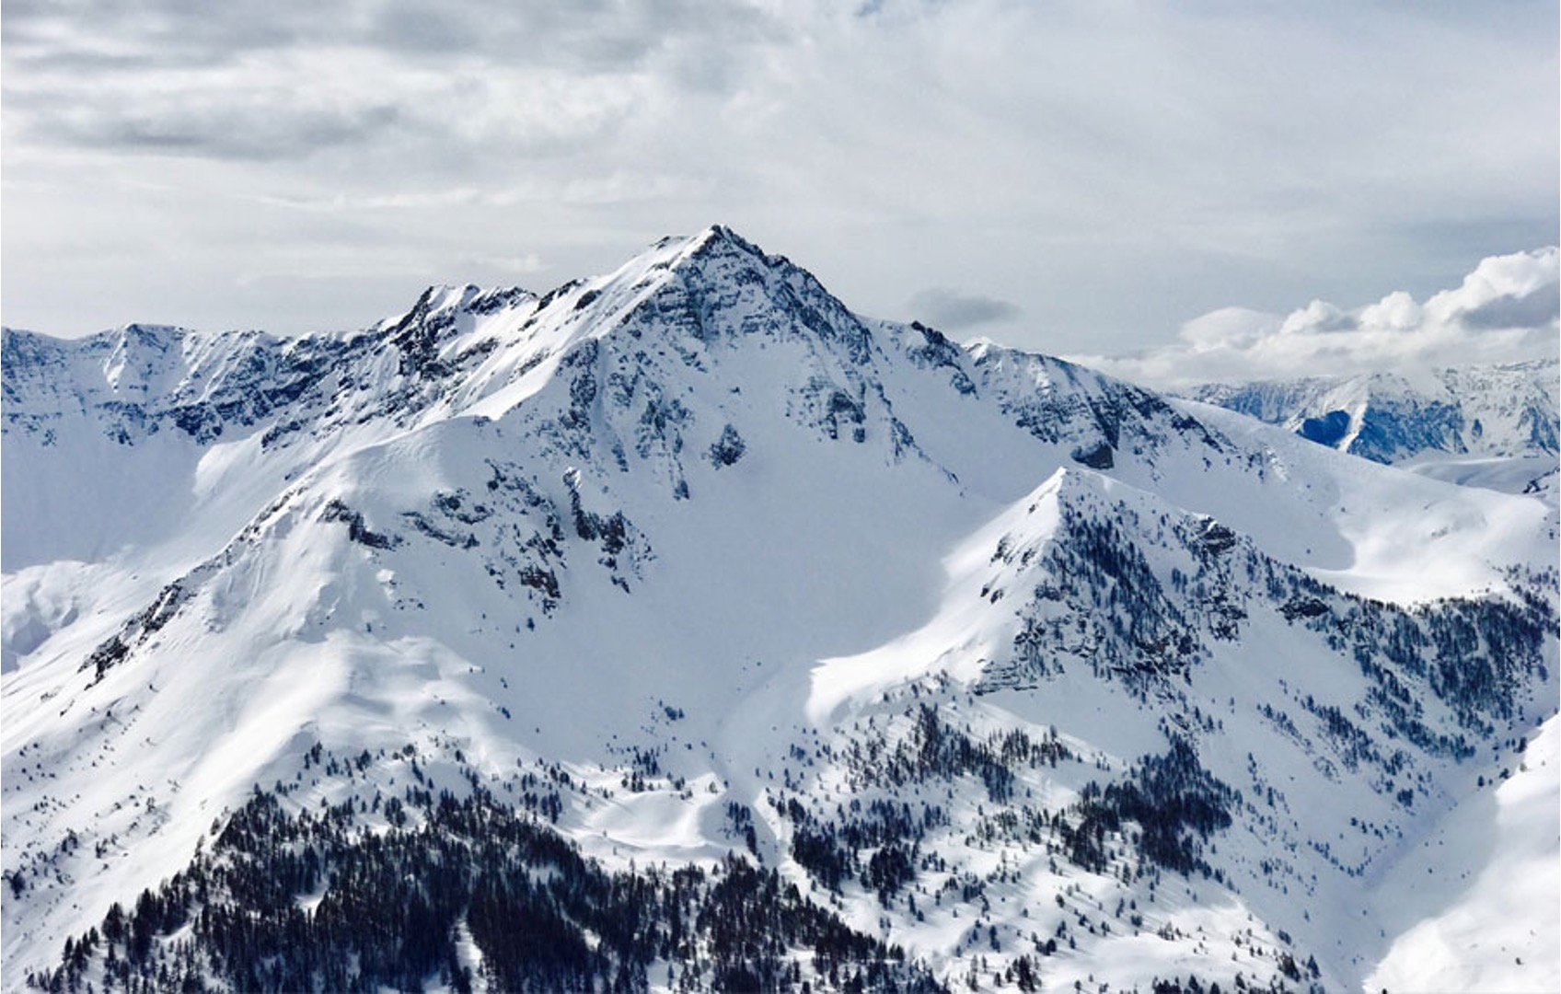
Big Mountain Resort: Price Adjustment Analysis
Guided Capstone Executive Presentation

Slide 2
1
Ski resort feature and ticket price data was compiled from Big Mountain’s nationwide competitors
An analysis using the data was conducted to assess whether Big Mountain, given its current feature makeup, should maintain or change its ticket price
2
Executive Summary
An additional analysis was conducted to assess how various infrastructure modifications would impact ticket prices
3
The analysis indicates Big Mountain should increase Adult Weekend ticket prices to $96 and add a run + chair to increase vertical drop and maximize profits
4

Slide 3
Problem Statement and Key Findings
Our Understanding of the Context:
Currently, Big Mountain bases ticket prices on a comparison to the average price of resorts in its market segment. By taking a more data driven approach and comparing to data from other resorts across the segments, it may be possible to increase profits by pricing more appropriately (i.e., higher) and/or shut down services, thus saving costs, without impacting ticket sales.
Problem Statement:
This analysis seeks to identify opportunities for Big Mountain Resort to increase profits by 10% over the next ski season through increasing ticket prices, shutting down services that will not impact customer ticket purchases, or a combination of both.
Key Findings:
$96
recommended adult weekend ticket price
+$26.3M
est. revenue increase with price adjustment
-$1.5M
recommended investment to add one chairlift and run
+$24.8M
est. profit increase with recommended changes
Given Big Mountain’s current facilities and features, Big Mountain could raise prices from $81 to $96 without losing customers
This price increase would result in an estimated revenue increase of $26.3M assuming customer ticket volume remains constant at 350,000 per season and 5 tickets per customer
In addition, building a run and chair that adds additional vertical drop is an investment that will support future price increases and be profitable after one season. It will also signal to customers that the price increases are going directly to facility investments
The recommended price increase and investment will increase profits by an estimated $24.7M and allow for future price increases once the chair and run are operational

Slide 4
Analysis Process Overview
The steps below were used to build a model which used ski resort features as inputs and predicted the price customers would be willing to pay for those features. The data used as inputs were from Big Mountain’s national competitors.
Problem Identification
Data Wrangling
Exploratory Data Analysis
Preprocessing & Training
Modeling
Worked with stakeholders to identify the problem and gather relevant data.
Initial data set included information regarding 27 independent features at 330 resorts nationwide.
Cleaned the data set and added data regarding state demographics.
Decided to focus analysis on adult weekend ticket prices since more information was available
Final data set included information regarding 33 features at 277 resorts nationwide (including BMR)
Augmented data set to include more pertinent metrics (e.g., resort’s share of state’s total skiable area)
Assessed data to identify patterns and correlations among variables.
Total snowmaking area, number of runs and fast quads, and vertical drop were most positively correlated with price
Built and trained two models on the data set. Analyzed the performance of each model and selected the best performing model.
The random forest model was selected for use due to its lower error and variability.
Used the random forest model and trained it using the full data set.
Big Mountain’s feature data was input into the model to predict the price customers would pay.
Scenario analysis was conducted to predict how much prices could rise given specific infra improvements.

Slide 5
Model Build, Results, and Analysis
The model suggests Big Mountain Resort should increase ticket prices to $96 and invest $1.54M to build an additional chair and run to increase vertical drop
Model build methodology: a random forest model to predict ticket prices was built using 33 distinct parameters from 276 of Big Mountain’s competitors
Input parameters from 276 competitor resorts:
Summit Elevation | # runs | # resorts per state
Vertical Drop | # terrain parks | # resorts / 100k people
Base Elevation | Longest run distance | # resorts / 100k sq miles
# Trams | Skiiable terrain area | Resort skiable area / state area
# fast sixes | Snow making area | Resort days open / total days open in state
# fast quads | Days open last year | # resort terrain parks / # state terrain parks
# quads | # years open | Resort night skiing area / state night skiing area
# triples | Avg. snowfall | Total chairs / total runs
# doubles | Adult Weekend Ticket Price | Total chairs / total skiable area
# surface | Projected days open | # fast quads / # runs
# chairs | Night Skiing area | # fast quads / total skiable area
Big Mountain Resort features (same as input parameters)
Random Forest Model to predict ticket price
Input
Model Training
Ticket price customers would be willing to pay for Big Mountain Resort
Output
Model Results and Analysis
$95.87
recommended adult weekend ticket price
The following was input into the model to estimate how much more customers would be willing to pay for each scenario
# | Feature Modification Scenario | Ticket Price Impact | Seasonal Revenue Impact | Directional Cost Impact
1 | Permanently closing down up to 10 of the least used runs | $0 (1 run) -$1.75 (10 runs) | $0 (1 run) -$3M (10 runs) | ↓
2 | Increase the vertical drop by adding a run to a point 150 feet lower down but requiring the installation of an additional chair lift to bring skiers back up, without additional snow making coverage. | +$1.99 | +$3.47M | ↑
3 | Same as number 2, but adding 2 acres of snow making coverage. | +$1.99 | +$3.47M | ↑↑
4 | Increase the longest run by 0.2 mile to boast 3.5 miles length, requiring an additional snow making coverage of 4 acres. | $0 | $0 | ↑
+/- $10.39
the model has an average error of +/-$10.39. This suggests that at minimum, Big Mountain should increase its ticket price to $85.48

Slide 6
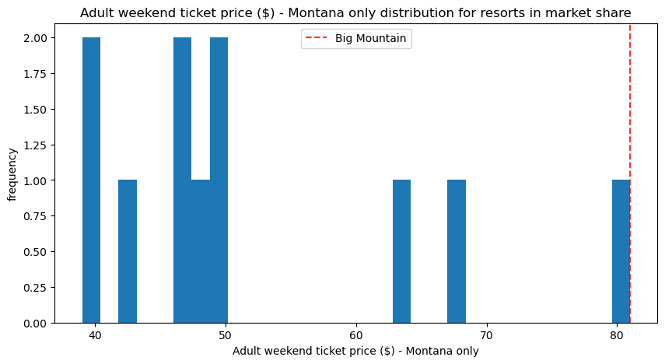
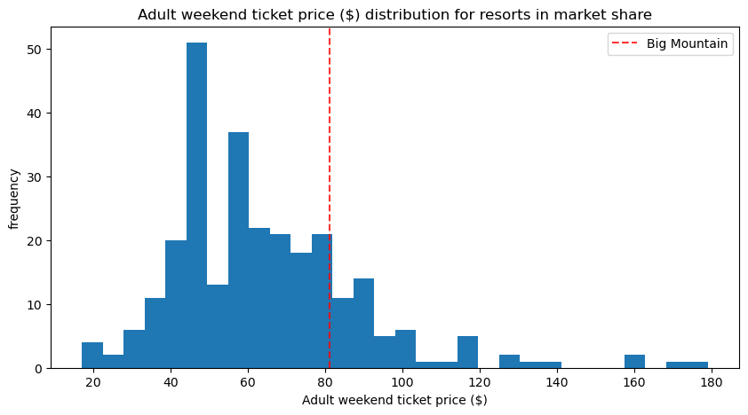
Price Increase Analysis
Big Mountain Resort already charges more than any other resort in Montana. However, when compared to the national market there is still room for price increases.
Distribution of Adult Weekend Ticket Price Across Montana Resorts
Distribution of Adult Weekend Ticket Price Across all Competitors
The model didn’t consider customer segmentation. If most customers originate from Montana, then they may be more sensitive to a price increase. However, if most customers travel from out of state, Big Mountain is well positioned to increase prices without negative repercussions.

Slide 7
Next Steps and Key Considerations
While the model suggests a price increase is warranted, the implementation of the price increase is important. Simultaneously raising prices while investing in infrastructure may mitigate negative customer perception.
The following data, if available, would help provide more accurate recommendations:
number of visitors to other resorts per season
average length of runs in each resort
Customer segmentation data (how many customers are local vs. travel to the resort etc)
ticket types available and breakdown of customers using ski passes vs. daily tickets (many customers now purchase ski passes and don't buy day tickets - this could greatly impact our projected revenue increase)
historical data regarding ticket price increases and facility enhancements
feature usage data (e.g., how many customers use each chair lift, etc)
A web app can be created to allow Big Mountain to use this model in the future to independently assess price impacts of new infrastructure modification scenarios

Slide 8
Appendix

Slide 9
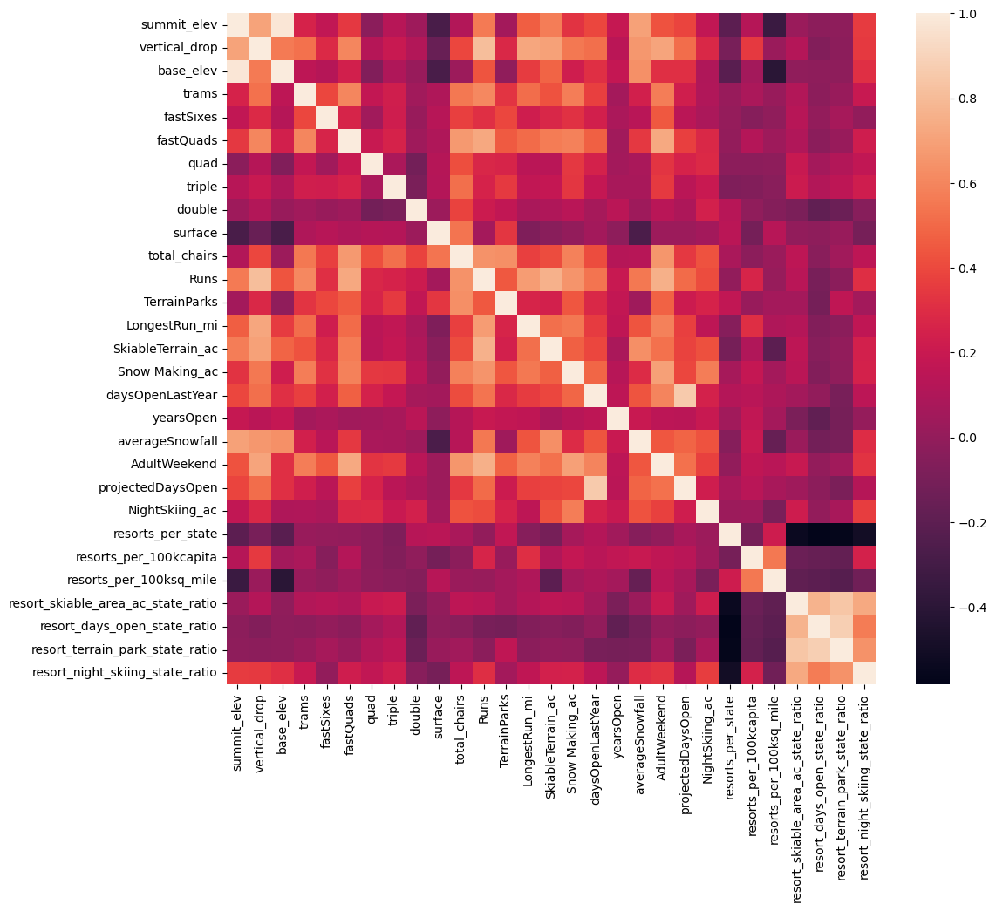
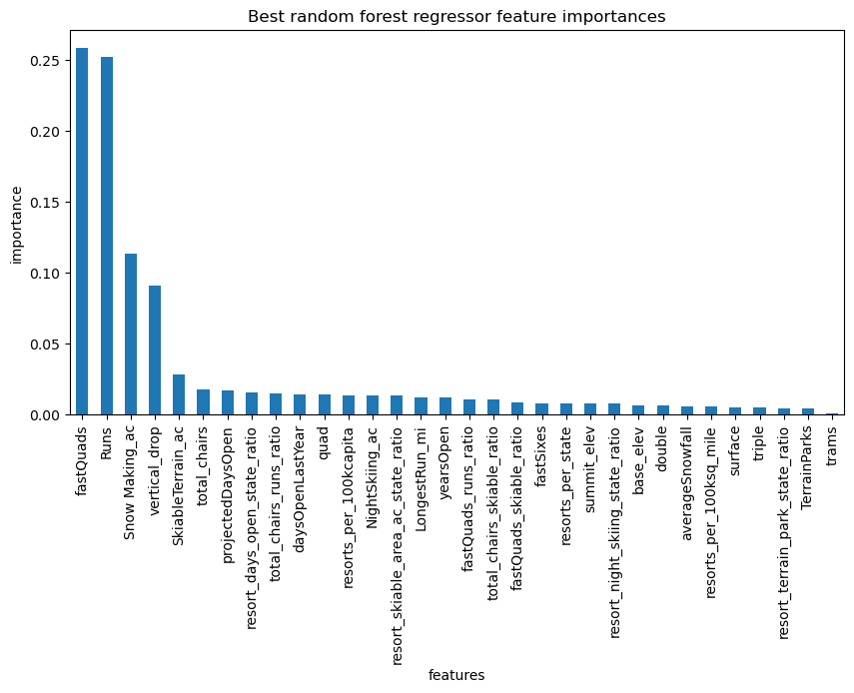
Appendix: Additional Model Insights
Resort Parameter Correlation Heatmap
Analysis of feature importance on ticket price (Random Forest Model)

